Slide 1
Data Modeling for
Database Design 1
Adapted from Yong Choi
School of Business
CSUB

Slide 2
Study Objectives
Understand concepts of data modeling and its purpose
Learn how relationships between entities are defined and refined, and how such relationships are incorporated into the database design process
Learn how ERD components affect database design and implementation
Learn how to interpret the modeling symbols

Slide 3
Table
“A table is the primary unit of physical storage for data in a database.”¹
Usually, a database contains more than one table.
1) Stephens, R.K. and Plew. R.R., 2001. Database Design. SAMS, Indianapolis , IN.

Slide 4
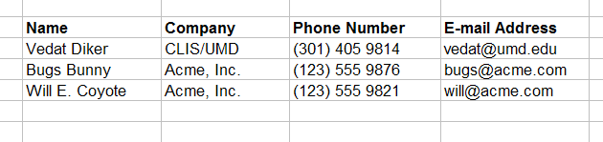
Table
A row represents one ‘record’ in a specific table
A column represents one attribute in a database

Slide 5
A Database with Multiple Tables
[1]
Publishers
Books
Customers
Authors
Inventory
Orders
1) Stephens, R.K. and Plew. R.R., 2001. Database Design. SAMS, Indianapolis ,
IN. (with slight changes by V.G.D.)

Slide 6
Table
Customers

Slide 7
Field (Column)
Customers
a field, or ‘attribute’

Slide 8
Record (Row)
Customers
a record

Slide 9
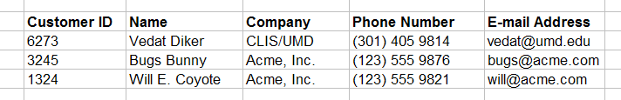
Primary Key
Customers
primary key field
Primary key is a unique identifier of records in a table.
Primary key values may be generated manually or automatically.

Slide 10
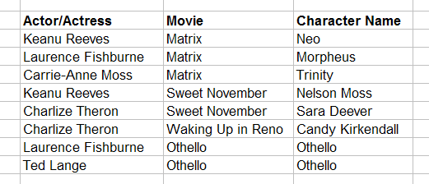
Primary Key
Roles (Performances)
primary key fields
A primary key can consist of more than one field.

Slide 11
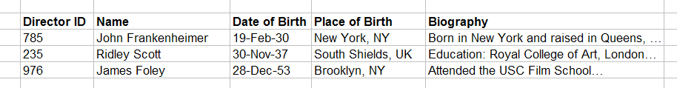
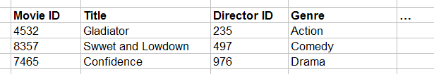
Foreign Key
primary key field
parent table
Directors
relationship
child table
Movies
foreign key field

Slide 12
Data Model
Model: an abstraction of a real-world object or event
  Useful in understanding complexities of the real-world environment
Data model
  A diagram that displays a set of tables and the relationships between them
  Next Slide: “Restaurant” Access data model using Entity Relationship Diagram (ERD)

Slide 13
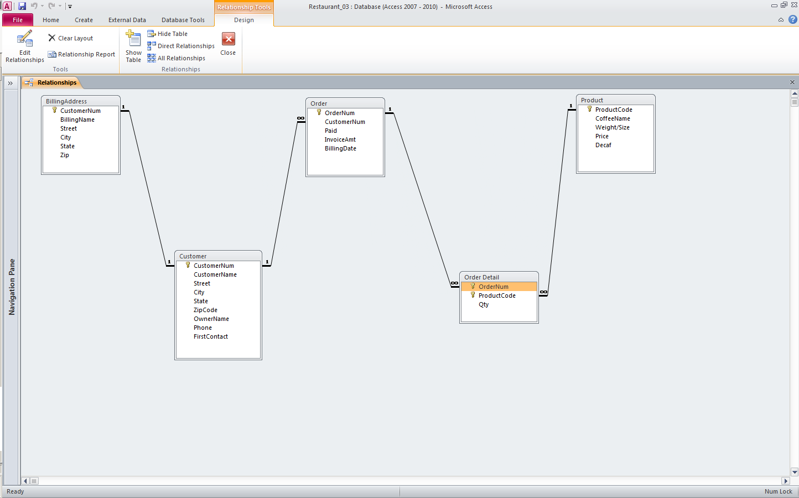
Access Data Model using ERD

Slide 14
What is an Entity Relationship Diagram (ERD)?
ERD is a data modeling technique used in software engineering to produce a conceptual data model of an information system.
So, ERDs illustrate the logical structure of databases.

Slide 15
The Importance of Data Model
Blue print: official documentation
  Blue print of house
Employee’s w/o DB knowledge can understand
  a data model diagram vs. a list of tables
  Used as an effective Communication Tool
  Improve interaction among the managers, the designers, and the end users
Independence from a particular DBMS
  Network DB, Object-oriented DB, etc.

Slide 16
Data Model (con’t)
The data modeling revolves around discovering and analyzing organizational and users data requirements.
Requirements based on policies, meetings, procedures, system specifications, etc.
  Identify what data is important
  Identify what data should be maintained
Notes:
7

Slide 17
ERD
The major activity of this phase is identifying entities, attributes, and their relationships to construct model using the Entity Relationship Diagram.
  Entity → table
  Attribute → column
  Relationship → line
Basics of Data Modeling Video
  Until business rules # 3 (9:20)
Notes:
7

Slide 18
How to find entities?
Entity:
  "...anything (people, places, objects, events, etc.) about which we store information (e.g. supplier, machine tool, employee, utility pole, airline seat, etc.).”
  Tangible: customer, product
  Intangible: order, accounting receivable
  Look for singular nouns (beginner)
  BUT a proper noun is not a good candidate….

Slide 19
Entity Instance
Entity instance: a single occurrence of an entity.
  6 instances
Entity: student
Student ID | Last Name | First Name
2144 | Arnold | Betty
3122 | Taylor | John
3843 | Simmons | Lisa
9844 | Macy | Bill
2837 | Leath | Heather
2293 | Wrench | Tim
instance

Slide 20
How to find attributes?
Attribute:
  Attributes are data objects that either identify or describe entities (property of an entity).
  In other words, it is a descriptor whose values are associated with individual entities of a specific entity type
    The process for identifying attributes is similar except now you want to look for and extract those names that appear to be descriptive noun phrases.

Slide 21
How to find relationships?
Relationship:
  Relationships are associations between entities.
  Typically, a relationship is indicated by a verb connecting two or more entities.
  Employees are assigned to projects
  Relationships should be classified in terms of cardinality.
    One-to-one, one-to-many, etc.

Slide 22
How to find cardinalities?
Cardinality:
  The cardinality is the number of occurrences in one entity which are associated to the number of occurrences in another.
  There are three basic cardinalities (degrees of relationship).
  one-to-one (1:1), one-to-many (1:M), and many-to-many (M:N)

Slide 23
Identifier
“attributes that uniquely identify entity instances”
Becomes a PK in RDS
Composite identifiers are identifiers that consist of two or more attributes
Identifiers are represented by underlying the name of the attribute(s)
  Employee (Employee_ID), student (Student_ID)
Notes:
18

Slide 24
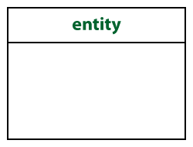
Crow’s Foot Notation
Known as IE notation (most popular)
Entity:
  Represented by a rectangle, with its name on the top. The name is singular (entity) rather than plural (entities).

Slide 25
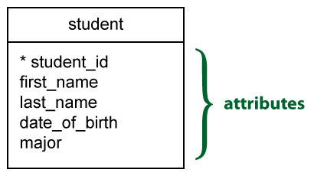
Attributes
Identifiers are represented by underlying the name of the attribute(s)

Slide 26



Basic Cardinality Type
1-to-1 relationship
1-to-M relationship
M-to-N relationship

Slide 27
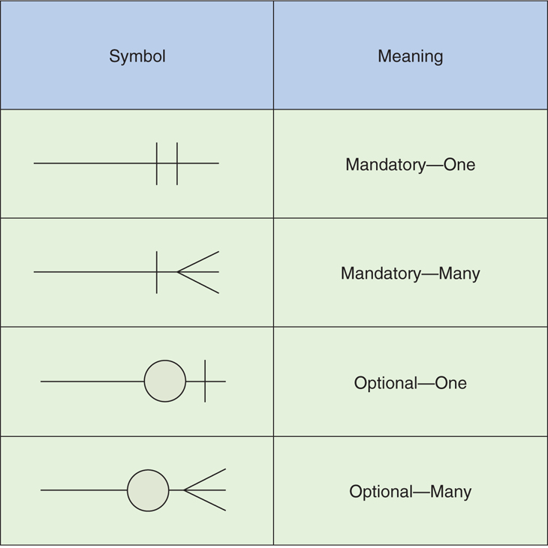
Cardinality con’t

Slide 28
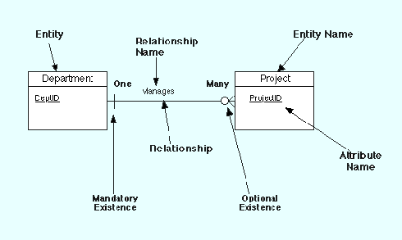
Example Model

Slide 29
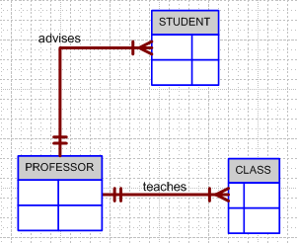
Business Rule Example 1
Finalized business rules must be bi-directional.
  Draft: one sentence
  Finalized: two sentences
A professor advises many students (professor to student). Each student is advised by one professor (student to professor).
A professor must teach many classes. Each class must be taught by one professor.

Slide 30
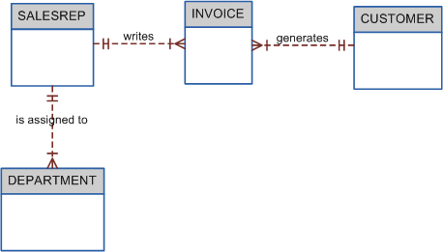
Business Rule Example 2
A sales representative must write many invoices. Each invoice has to be written by one sales representative.
Each sales representative must be assigned to many department. Each department has only one sales representative.
A customer has to generate many invoices. An invoice is generated by only one customer.

